Slide 1
DevOps Boot Camp 2021
Linux Fundamentals
MD MOSTAIN BILLAH

Slide 2
What is Linux?
LINUX is an operating system or a kernel distributed under an open-source license.
The kernel is a program at the heart of the Linux operating system that takes care of fundamental stuff, like letting hardware communicate with software.

Slide 3



Who created ?
Linus Torvalds
In 1991

Slide 4
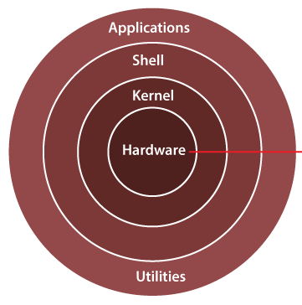
Linux Architecture

Slide 5
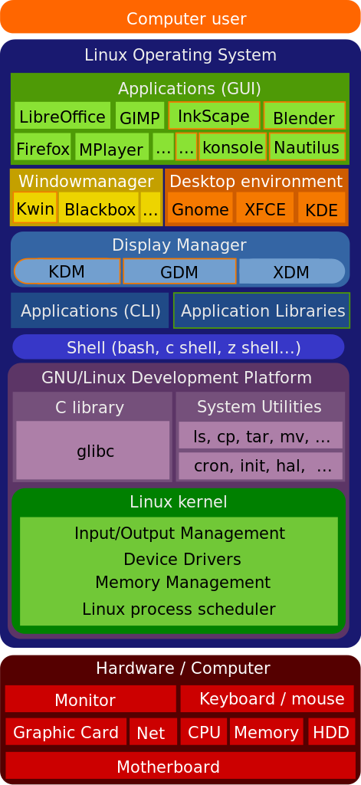
Linux Architecture
More detailed…
GDM - GNOME Display Manager

Slide 6
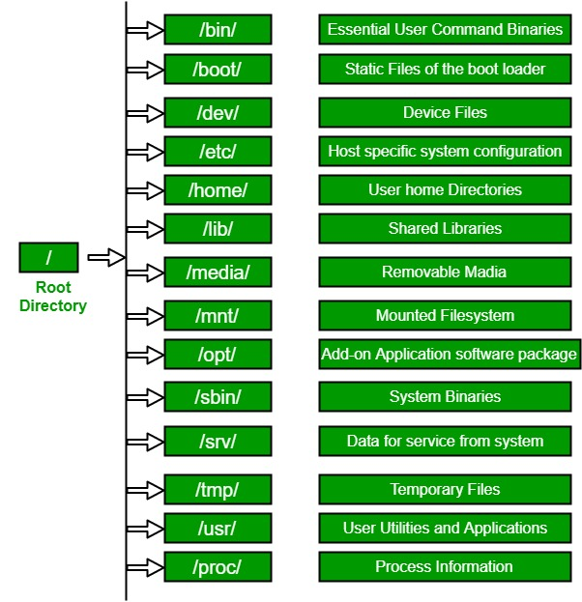
Linux File System
The Filesystem Hierarchy Standard - FHS

Slide 7
What is Shell?
The original Unix shell program written by Steve Bourne.
In computing, a shell is a computer program which exposes an operating system's services to a human user or other program.

Slide 8
OS Version
machine name, operating system, kernel
cat /etc/os-release
lsb_release -a
hostnamectl
uname

Slide 9
Basic Commands
ls
pwd
man
whereis
whatis
whoami
top
free
du
df
clear
passwd
cd
mkdir
touch
echo
cat
rm
rmdir
nano
vim
zip
unzip
tar
ufw
stat
find
useradd
groupadd
chmod
chown
type

Slide 10
ls -l
Gives detailed information of the files
Column | Description
1st Column | File Attribute - File type and access permissions 1st character f = File, d = Directory, l = Link The next 9 character is about file permission
2nd Column | # of HardLinks to the File This tells us about how many link to this file
3rd Column | Owner and the creator of the file
4th Column | Group of the owner
5th Column | File size in bytes
6th Column | Date & Time
7th Column | Directory or File name
The command provides information in a columnar format

Slide 11
File Attribute
stat -c '%a %n' *
stat -c '%a %A %U %G %s %n' *
stat -c '%a %A %U %G %s %n'. /Desktop
File type | File Mode
- | r | w | x | r | - | x | r | - | x

Slide 12
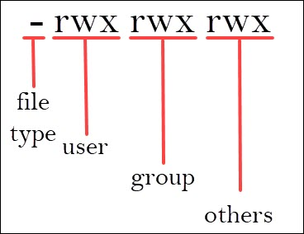
File Permission
File type | User / Owner (u) |  |  | Group (g) |  |  | Other (o)
- | r | w | - | r | w | - | r | - | -

Slide 13
File Type
Attribute | File type
- | A regular file
d | A directory
l | A symbolic link
c | A character special file. This file type refers to a device that handles data as a stream of bytes, such as a terminal or /dev/null.
b | A block special file. This file type refers to a device that handles data in blocks, such as a hard drive or DVD drive.
s | Local socket file
p | Named pipe

Slide 14
Permission Attribute
Attributes | Files | Directories
r | Allows a file to be opened and read. | Allows a directory’s contents to be listed if the execute attribute is also set.
w | Allows a file to be written to or truncated; however, this attribute does not allow files to be renamed or deleted. The ability to delete or rename files is determined by directory attributes. | Allows files within a directory to be created, deleted, and renamed if the execute attribute is also set.
x | Allows a file to be treated as a program and executed. Program files written in scripting languages must also be set as readable to be executed. | Allows a directory to be entered, Example: cd directory.

Slide 15
Change File Mode
chmod -
chmod supports two distinct ways of specifying mode changes.
Octal number representation
Symbolic representation

Slide 16
1# Octal Mode
#Octal number representation
chmod [options] mode filename
Example:
$ chmod -R 774 test.txt
options:
recursive: -R
force : -f
verbose: -v
mode:
r: read (4)
w: write (2)
x: execute (1)

Slide 17
File Modes in Binary and Octal
Octal | Binary | File Mode | Name
0 | 000 | --- | No permission
1 | 001 | --x | Execute
2 | 010 | -w- | Write
3 | 011 | -wx | Write+Execute
4 | 100 | r-- | Read
5 | 101 | r-x | Read+Execute
6 | 110 | rw- | Read+Write
7 | 111 | rwx | Read+Write+Execute

Slide 18
2# Symbolic Mode
#Symbolic Representation
$ chmod references operator modes file
example: chmod u+x filename
references:
u: owner of the file
g: group
o: users who are neither u nor g
a: all ugo
operator:
+: adds mode
-: remove mode
=: exact mode
mode:
r: read
w: write
x:execute

